Slide 1

The Machine Learning Process
What do I need to know about
the pandas index? (Part 2)
Dr. Reza Dibaj

Slide 2
Knowing more about the index
Why does the index exist?
Identification
Selection
Alignment

Slide 3
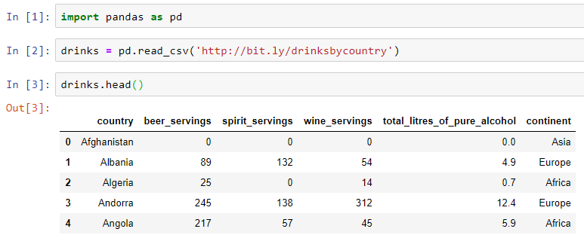
Knowing more about the index
Let’s pull up an example dataset as follows:
Notes:
import pandas as pd
drinks = pd.read_csv('http://bit.ly/drinksbycountry’)
drinks.head()

Slide 4
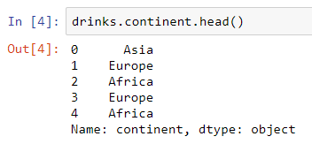
Knowing more about the index
A Series also has an index and it comes from a DF.
Notes:
drinks.continent.head()

Slide 5
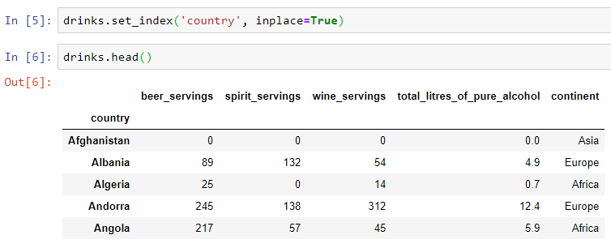
Knowing more about the index
What if we change the index to something else….
Notes:
drinks.set_index('country', inplace=True)
drinks.head()

Slide 6
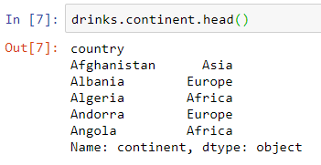
Knowing more about the index
We select the continent Series again, and here is the result:
Notes:
drinks.continent.head()

Slide 7
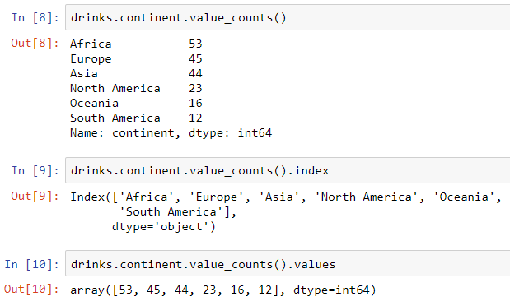
Knowing more about the index
With this definition of index, we realize that we have used indexes for Series before….
Notes:
drinks.continent.value_counts()
drinks.continent.value_counts().index
drinks.continent.value_counts().values

Slide 8

Knowing more about the index
Let’s try selecting a specific value from a Series, using the index.
It is similar to DF.loc[] that we have used before.
Notes:
drinks.continent.value_counts()['Africa']

Slide 9
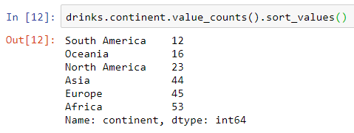
Knowing more about the index
How about sorting a Series?
Notes:
drinks.continent.value_counts().sort_values()

Slide 10
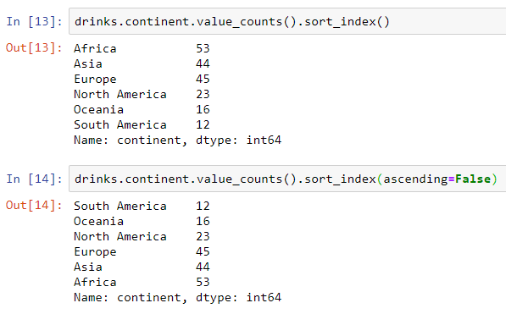
Knowing more about the index
And how about sorting a Series based on its index?
Notes:
drinks.continent.value_counts().sort_index()
drinks.continent.value_counts().sort_index(ascending=False)

Slide 11
Knowing more about the index
Why does the index exist?
Identification
Selection
Alignment

Slide 12
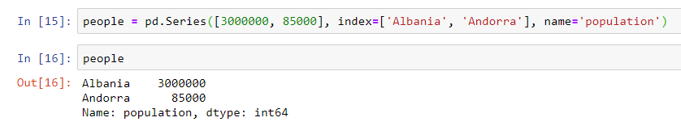
Knowing more about the index
For checking the alignment, let’s create a Series as follows:
Notes:
people = pd.Series([3000000, 85000], index=['Albania', 'Andorra'], name='population’)
People

Slide 13
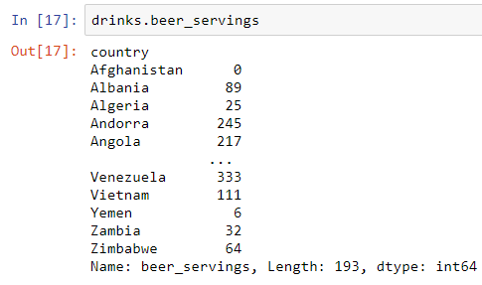
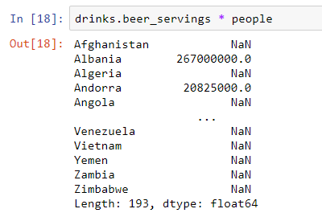
Knowing more about the index
We want to use this created Series and a Drinks dataset to calculate the total beer-servings for each country. (Multiplying the number of people and the beer-servings(avg/person))
Notes:
drinks.beer_servings * people

Slide 14
Knowing more about the index
Here is what we meant by alignment by the Series.
The alignment let us put data together, telling which rows correspond with which other rows.
Notes:
drinks.beer_servings * people

Slide 15

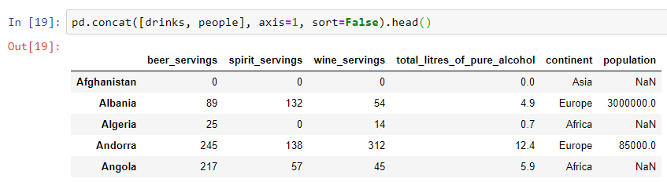
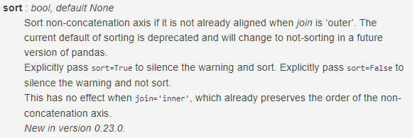
Bonus Tip
How can we take this people Series and add it to the DF?
https://pandas.pydata.org/pandas-docs/stable/reference/api/pandas.concat.html
It is needed to be set in the newer versions of pandas to silence the warning.

Slide 16

Thank you
Question?
To be
Not to be

